Slide 1
Microprocessors and Microcontrollers
Basic Connection

Slide 2
Needed Equipments
Microcontroller – ATmega32
The AVR Programmer / Loader
To load your code into the mc

Slide 3
Steps
Connect USBasp to PC
(Windows) Check Driver from Device Manager. If problem, update driver using zadig.
Install Extreme Burner
Connect USBasp with ATmega32
Write Code in Atmel
Upload hex to Atmega32 using Extreme Burner

Slide 4
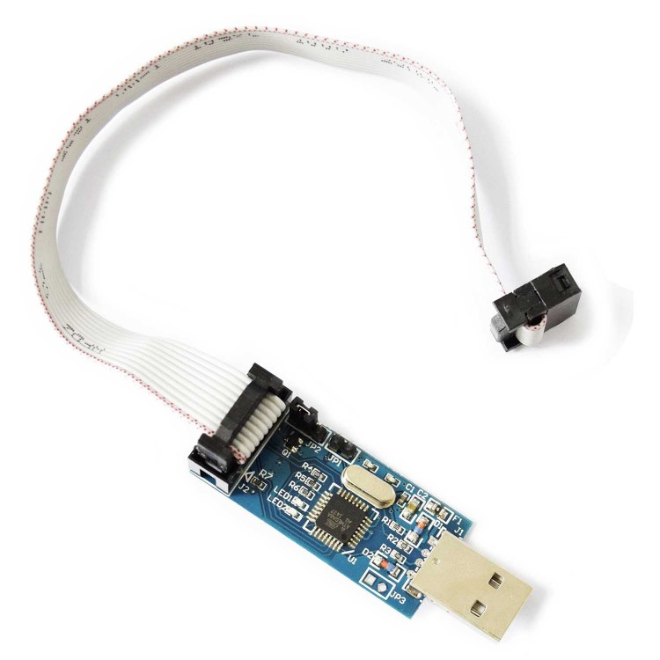
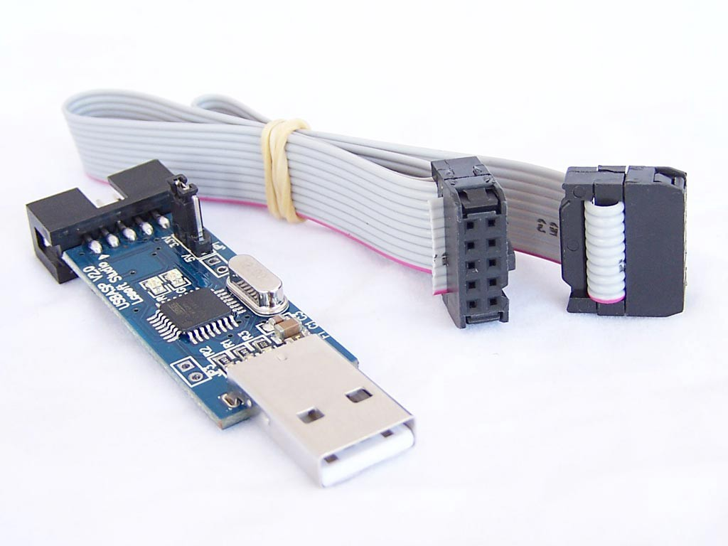
USBasp Programmer

Slide 5
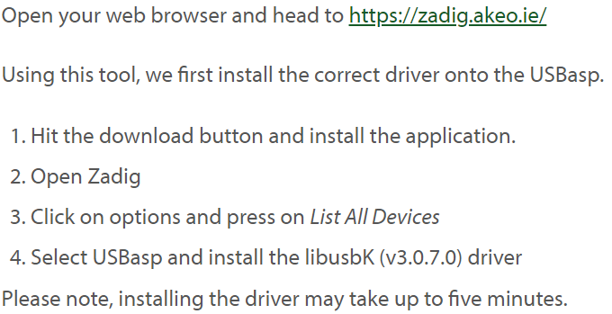
USBasp Programmer Driver Troubleshoot (only for Windows 10)
(Step 1: Installing the USBasp Driver Using Zadig) https://www.instructables.com/Programming-Microcontrollers-With-a-USBasp-Program/

Slide 6
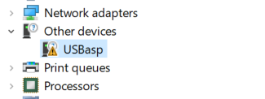
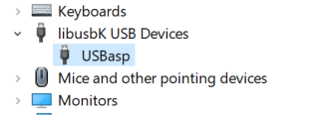
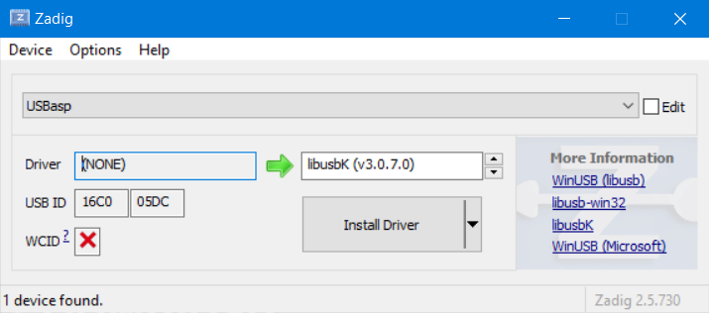
USBasp Programmer Driver Troubleshoot (only for Windows 10)

Slide 7
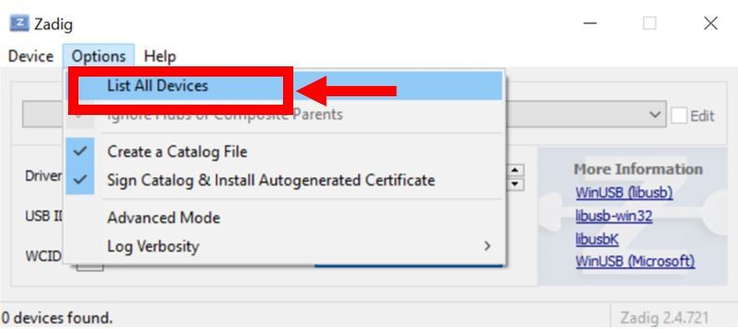
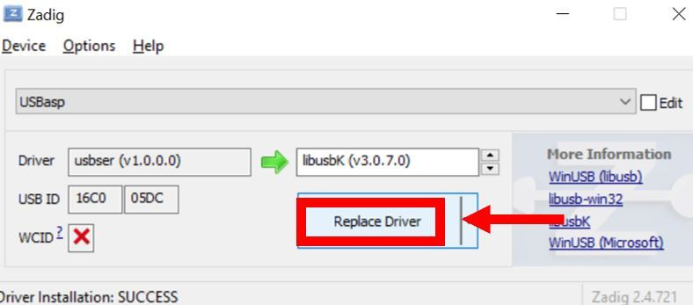
USBasp Programmer Driver Troubleshoot (only for Windows 10)
(Step 1: Installing the USBasp Driver Using Zadig) https://www.instructables.com/Programming-Microcontrollers-With-a-USBasp-Program/

Slide 8
Burner
Extreme Burner
http://extreme-burner-avr.software.informer.com/download/
There is also avrpal, avrdude
Loads the HEX file into microcontroller

Slide 9
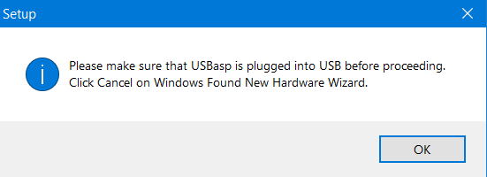
Burner

Slide 10
Needed Softwares
AVR Studio
https://www.microchip.com/mplab/avr-support/atmel-studio-7
Atmel Studio 7.0 (build 1931) offline installer
This is the IDE

Slide 11
Writing Code
Create New Project
Select “GCC C Executable Project”
Select path to save the project
You will later need this path for the hex file
Then select device type
Search for ATmega 32
Now you can write the program

Slide 12
Compile the hex code
Finish the program
Select “Build Solution (F7)” from the Build Menu
You will find that a hex file is generated in the Debug folder
The name of the hex file will be the same as your project name

Slide 13
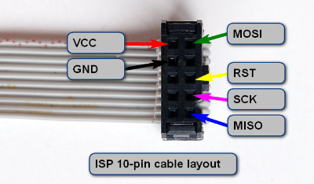
Connecting ATmega32 with programmer
Following the figure connect the 6 corresponding microcontroller pins with the loader.
Be careful about the orientation of the cable layout. The extended part goes to the right

Slide 14
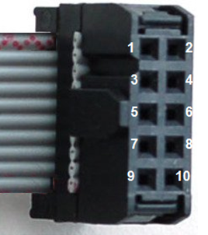
Connecting ATmega32 with programmer
1 = VCC (5V)
2 = MOSI
3 = GND
6 = RST
8 = SCK
10 = MISO
Depending on the connection of USBasp programmer, you may have to swap odd pins with even ones (e.g. 1 <-> 2, 3 <-> 4, 5 <-> 6 and so on)

Slide 15
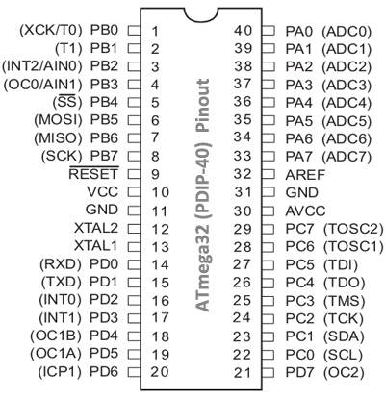
1 = VCC
2 = MOSI
3 = GND
6 = RST
8 = SCK
10 = MISO

Slide 16
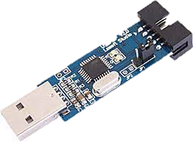
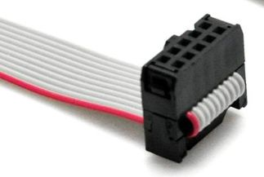
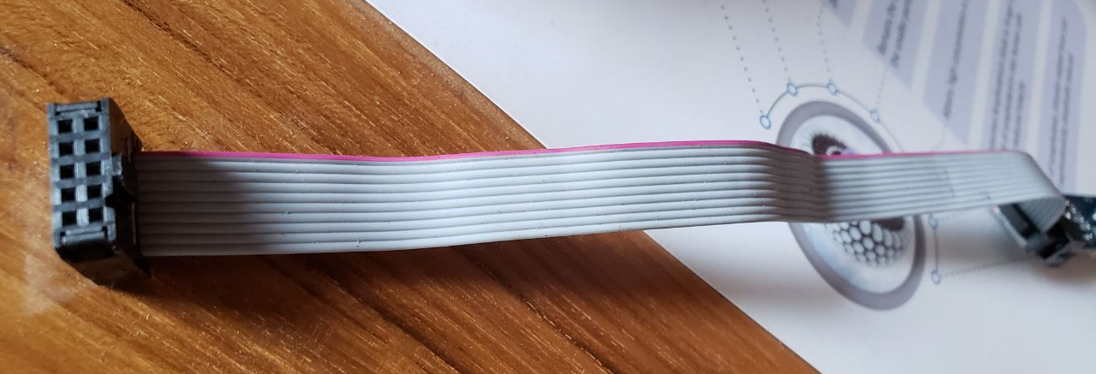
Connecting ATmega32 with programmer
Follow the red wire/stripped wire.
This wire should be #1 pin (VCC).

Slide 17
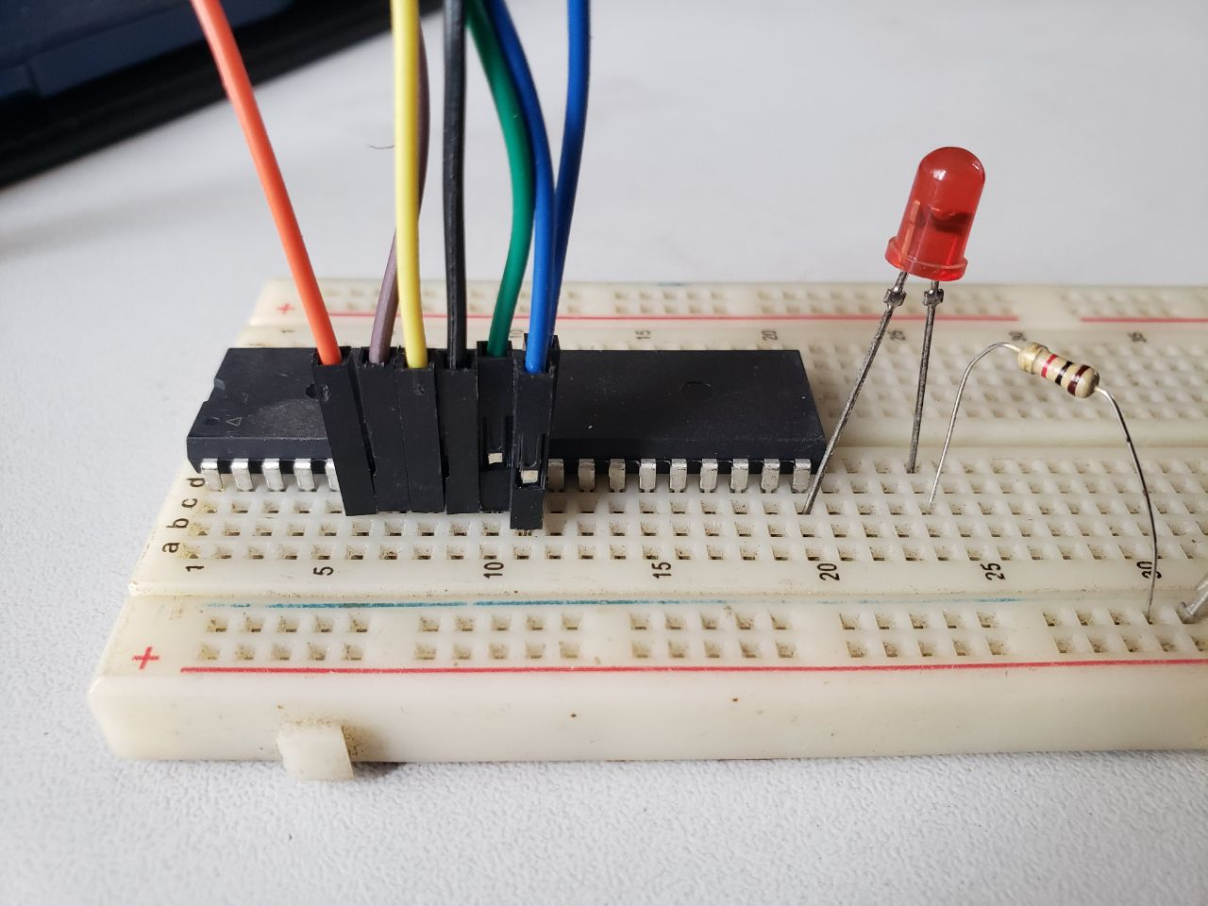
Today’s Task

Slide 18
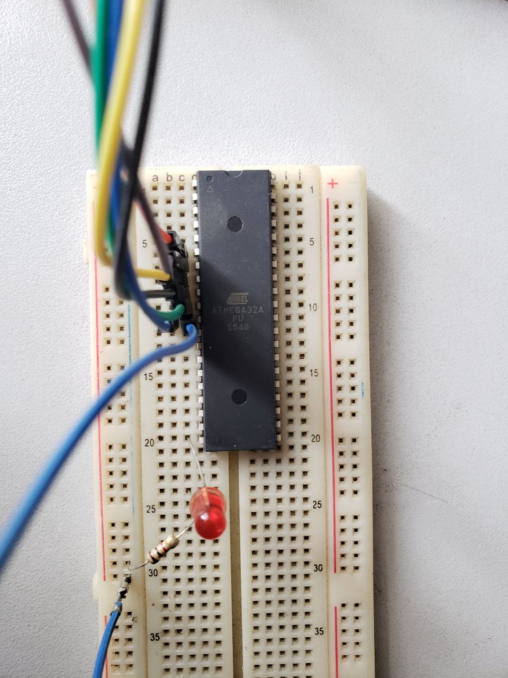
Today’s Task

Slide 19
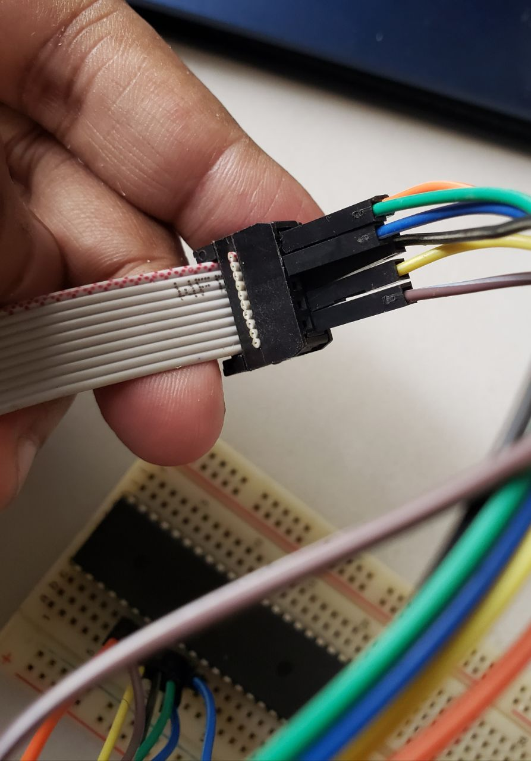
Today’s Task

Slide 20
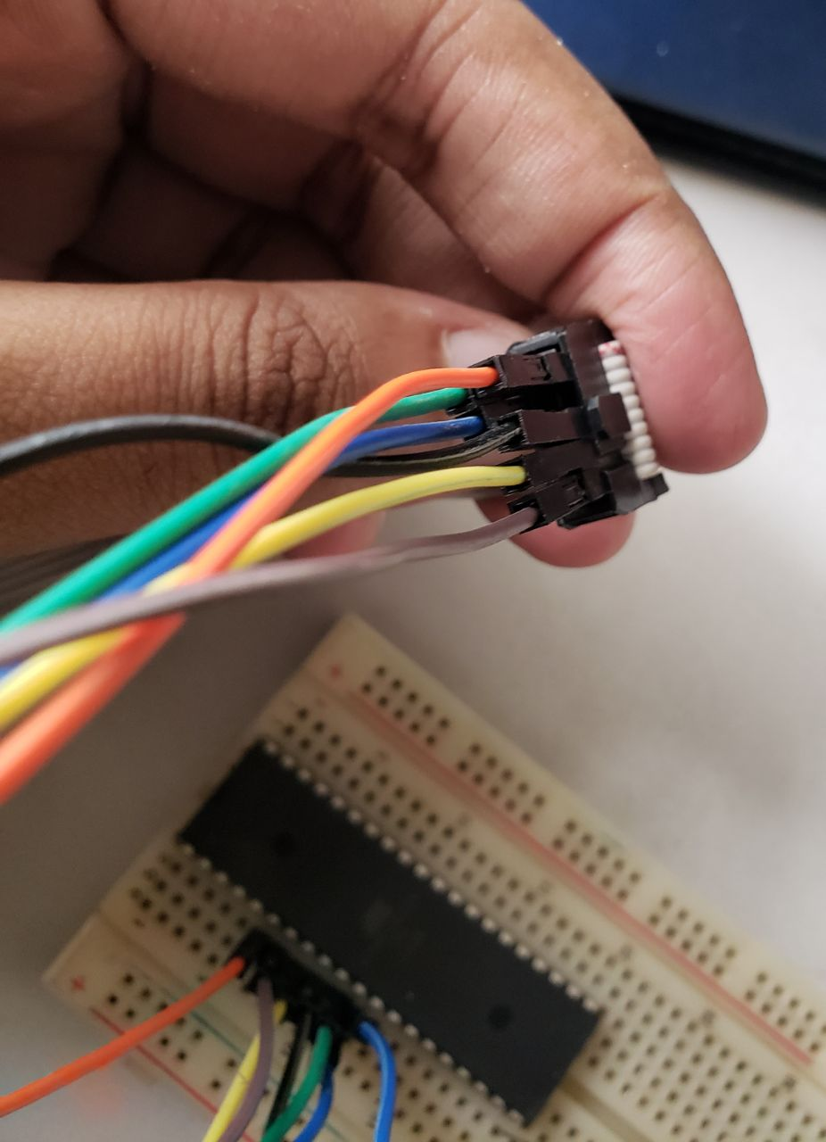
Today’s Task

Slide 21
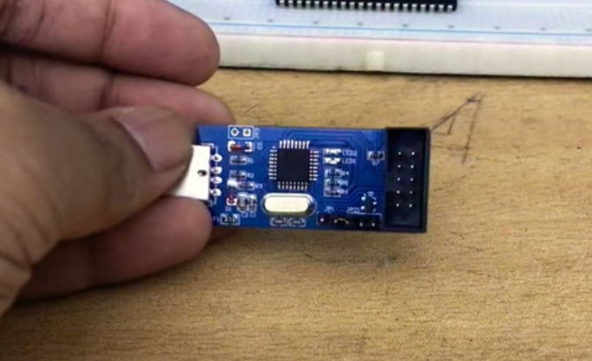
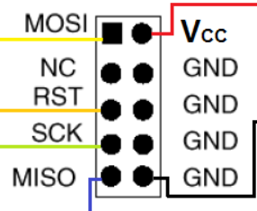
Connecting ATmega32 with programmer (Without Cable)
https://www.youtube.com/watch?v=bH8c8sMLfCI
Courtesy: Shanjinur Islam Spondon, CSE 15

Slide 22
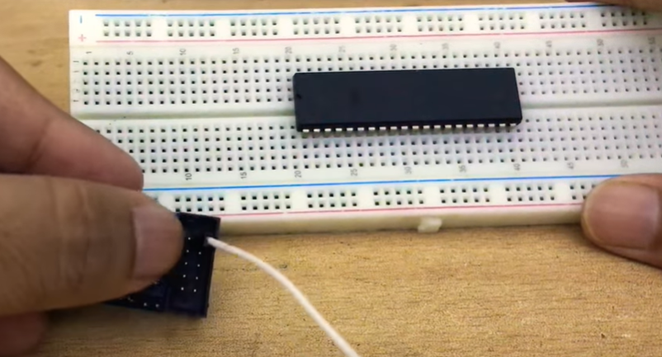
Placing ATmega32 on Breadboard
https://www.youtube.com/watch?v=bH8c8sMLfCI
Courtesy: Shanjinur Islam Spondon, CSE 15

Slide 23
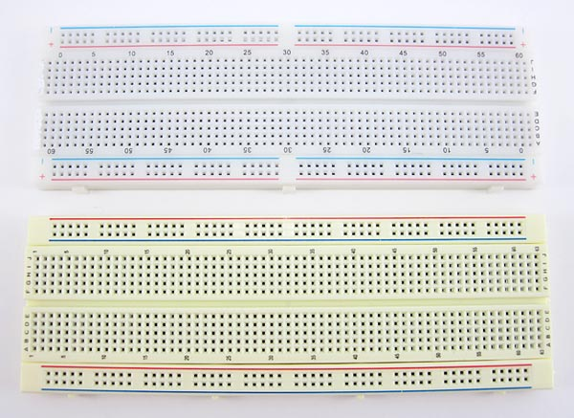
Breadboard

Slide 24
Breadboard

Slide 25
Load the hex into mc
Run Extreme Burner
Load the hex file into it by “Open” and locate your hex file
From menu select Chip -> ATmega32
Set the microcontroller on the AVR Programmer
Connect the programmer with PC
In extreme Burner select the menu “write” and choose “Flash”

Slide 26
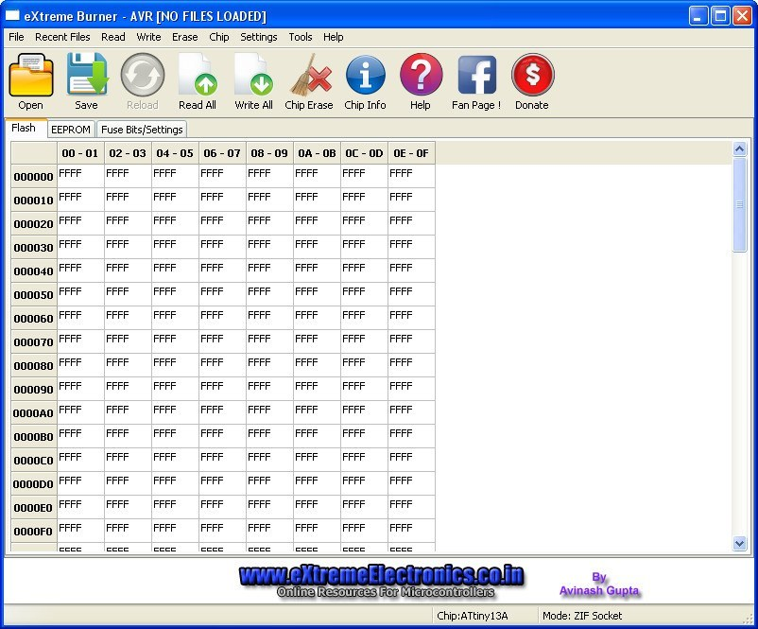
Load the hex into mc

Slide 27
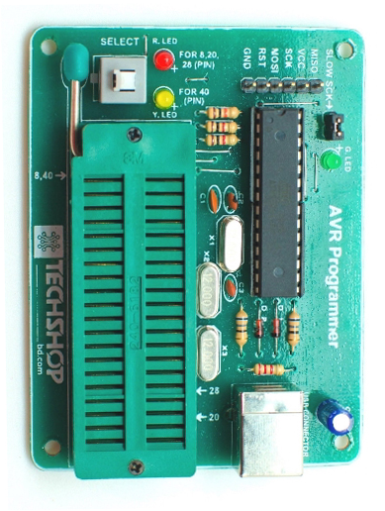
Setting mc in the AVR Programmer (USBasp alternative)
For the big loaders from TechshopBD
The upper portion (U) side goes closer to the side with the liver
There is a push button
Push it so that the yellow LED is on and the red one is off

Slide 28
Complete Process of Programming a Microcontroller
Write the code
In ATMEL Studio, or other IDE
Compile it to a .hex file.
For ATMEL Studio, you will find the hex on the “Debug” folder in your project

Slide 29
Complete Process of Programming a Microcontroller
3. Inserting the .hex file into the microcontroller
Load the hex file into burner
set the microcontroller on the “AVR Programmer”
Write
4. Set the microcontroller in the working circuit

Slide 30
☺

